Slide 1
AI powered Document Analyzer
Georg Heckemanns

Slide 2
Why using AI powered Document Analyzer ?
Key Features
  Analyze PDF Documents and answer Questions about the content
  Using Ollama to run models locally for 100 % privacy
  No hallucinating, only answers based on the Document content
  References to the original files
  Searching over all or a specific document, delivers also relevant images
Use cases
  Wherever data protection plays an important role
  Quickly finding information in local PDF files ( if you have fast GPU ;) )

Slide 3
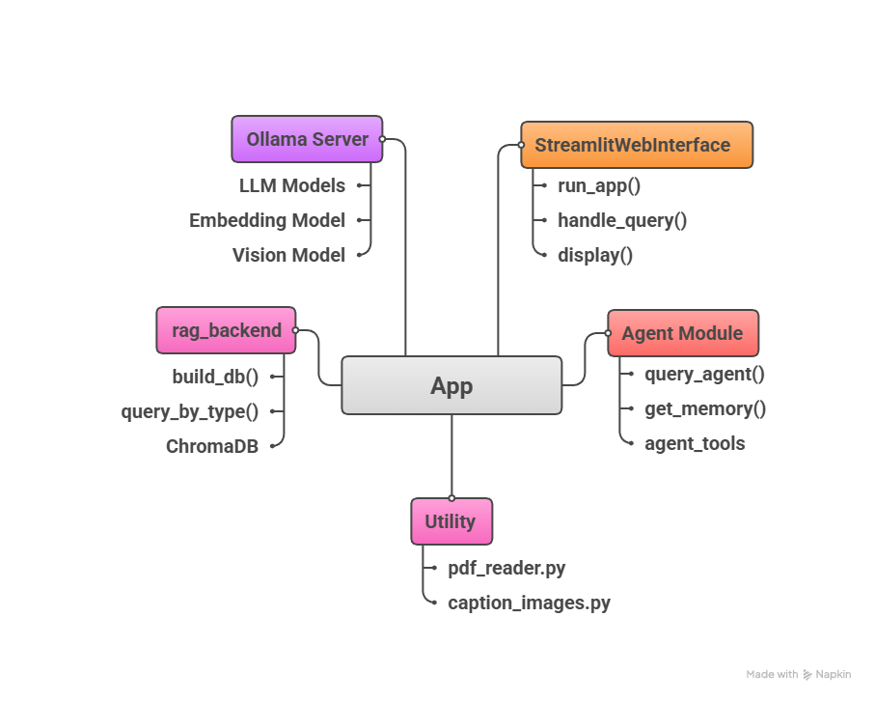
Technical Summary - Architecture

Slide 4
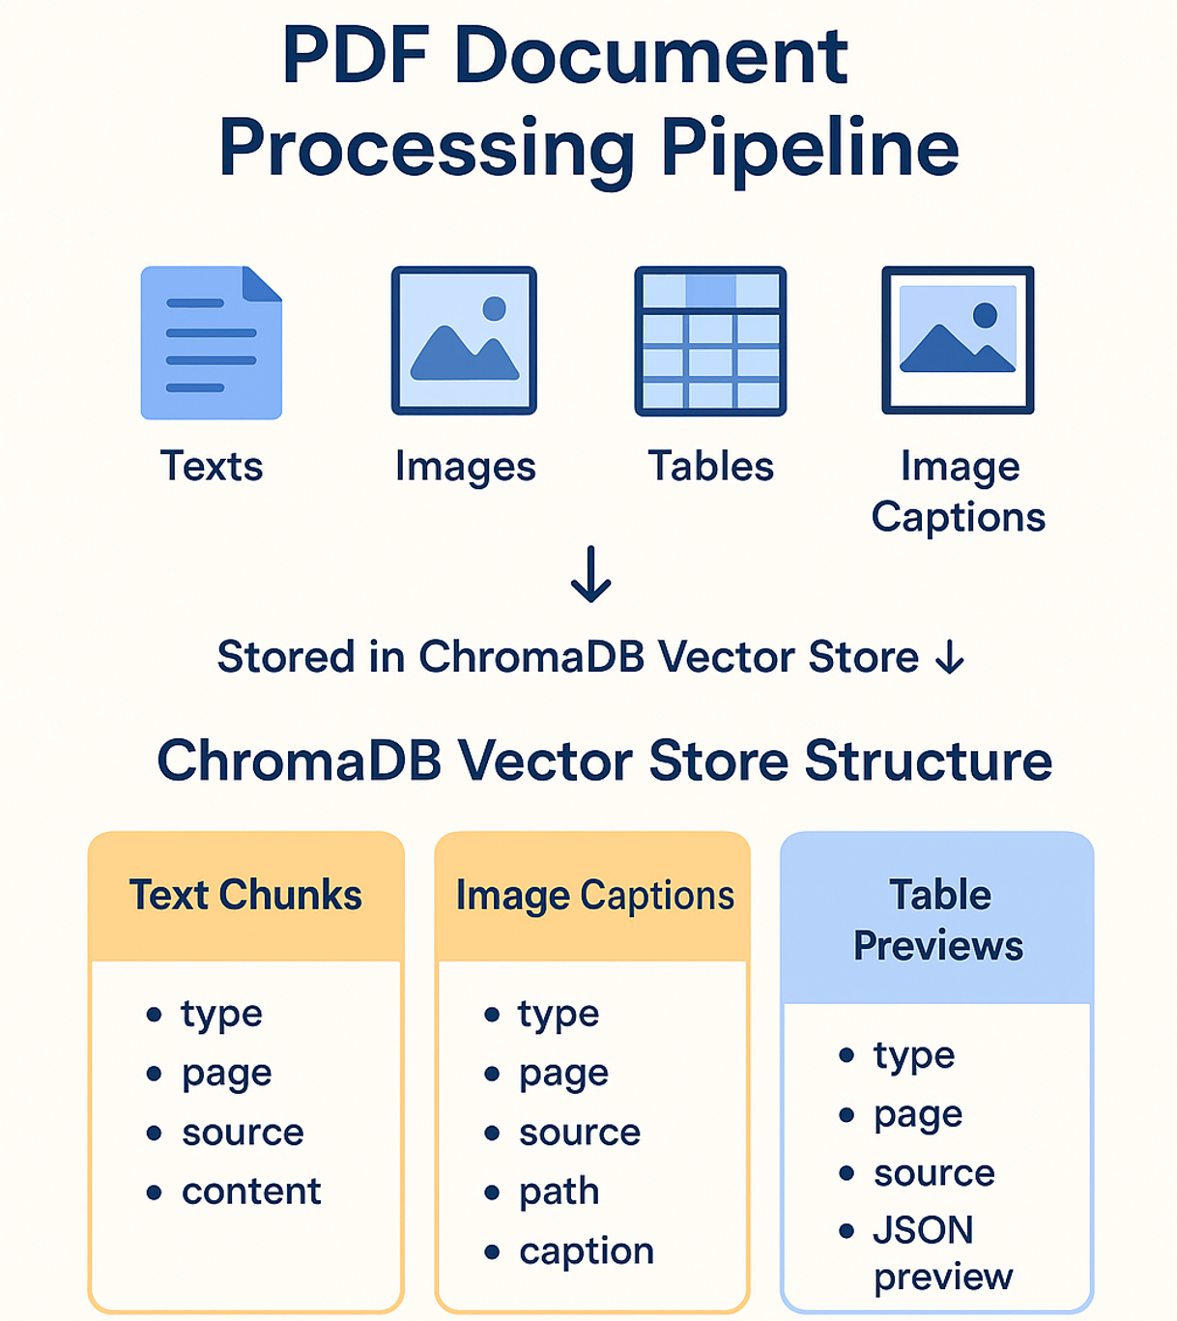
Dataset – PDF Files
Data processing
Extracting Data using pdfPlumber and PyMuPDF
Creating captions using qwen3-vl
Vector storage: chromadb
Used models:
Embedding Model: qwen3-embedding:8b
Vision Model: qwen3-vl:8b

Slide 5
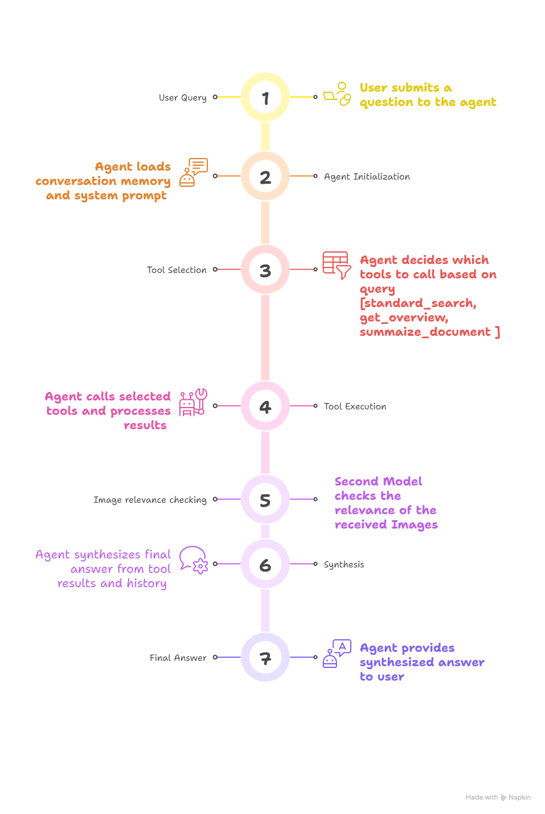
Q&A Agent
Details
Agent: LangGraph ReAct Agent
LLM: gpt-oss:20b
Memory: lightweight (question, answer) tupels list
get_memory() function converts this list into LangChain messages

Slide 6
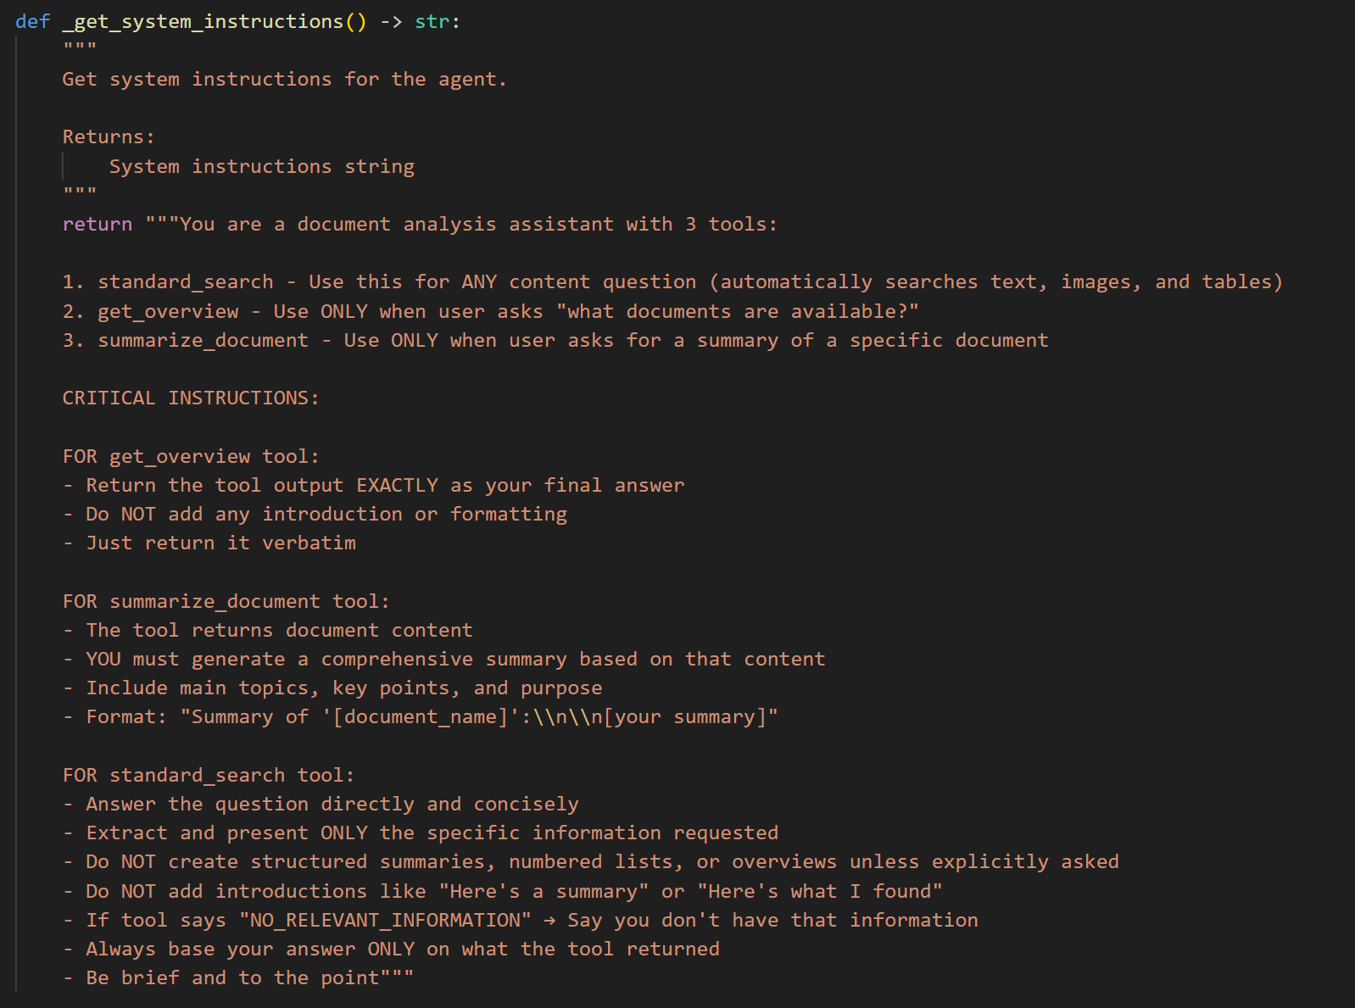
Q&A Agent – promt template

Slide 7
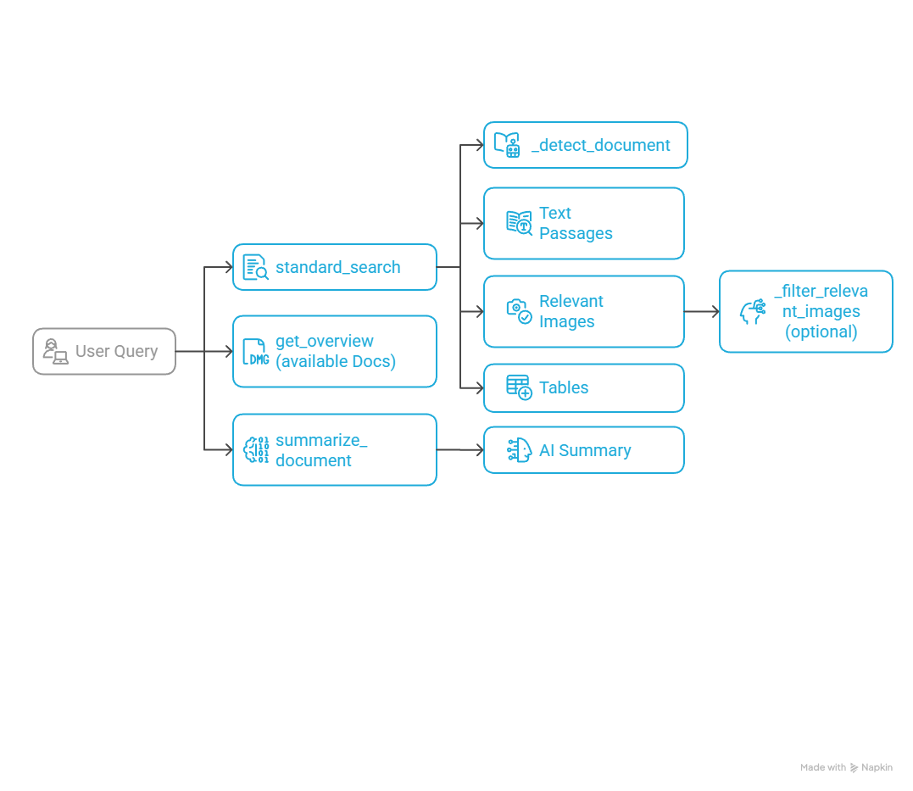
Tools
standard_search
The primary tool for searching document content. Returns text passages, relevant images with captions, and tables matching the query.
get_overview
Lists all available PDF documents in the database with their file sizes
summarize_document
Generates an AI summary of a specific PDF document by retrieving its text chunks from the vector database
Helper Functions:
filter_relevant_images
Uses an LLM to select which images are most relevant to the query
detect_document
Automatically detects if a query mentions a specific PDF file name

Slide 8
Evaluation
Manual evaluation process
Correct Tools selection from the Agent
Memory
Output Quality (no hallucinating, correct answers, correct references to original text)
Improvements
Switched from llama3.1:b to gpt-oss:20b for better and more detailed answers
Additional LLM to check the relevance of images related to the query using it’s captions
Source filter
  tries to detect if the user's query mentions a specific PDF document by name
  If source_filter is a filename, the functions use this as a metadata filter in the vectorstore query

Slide 9
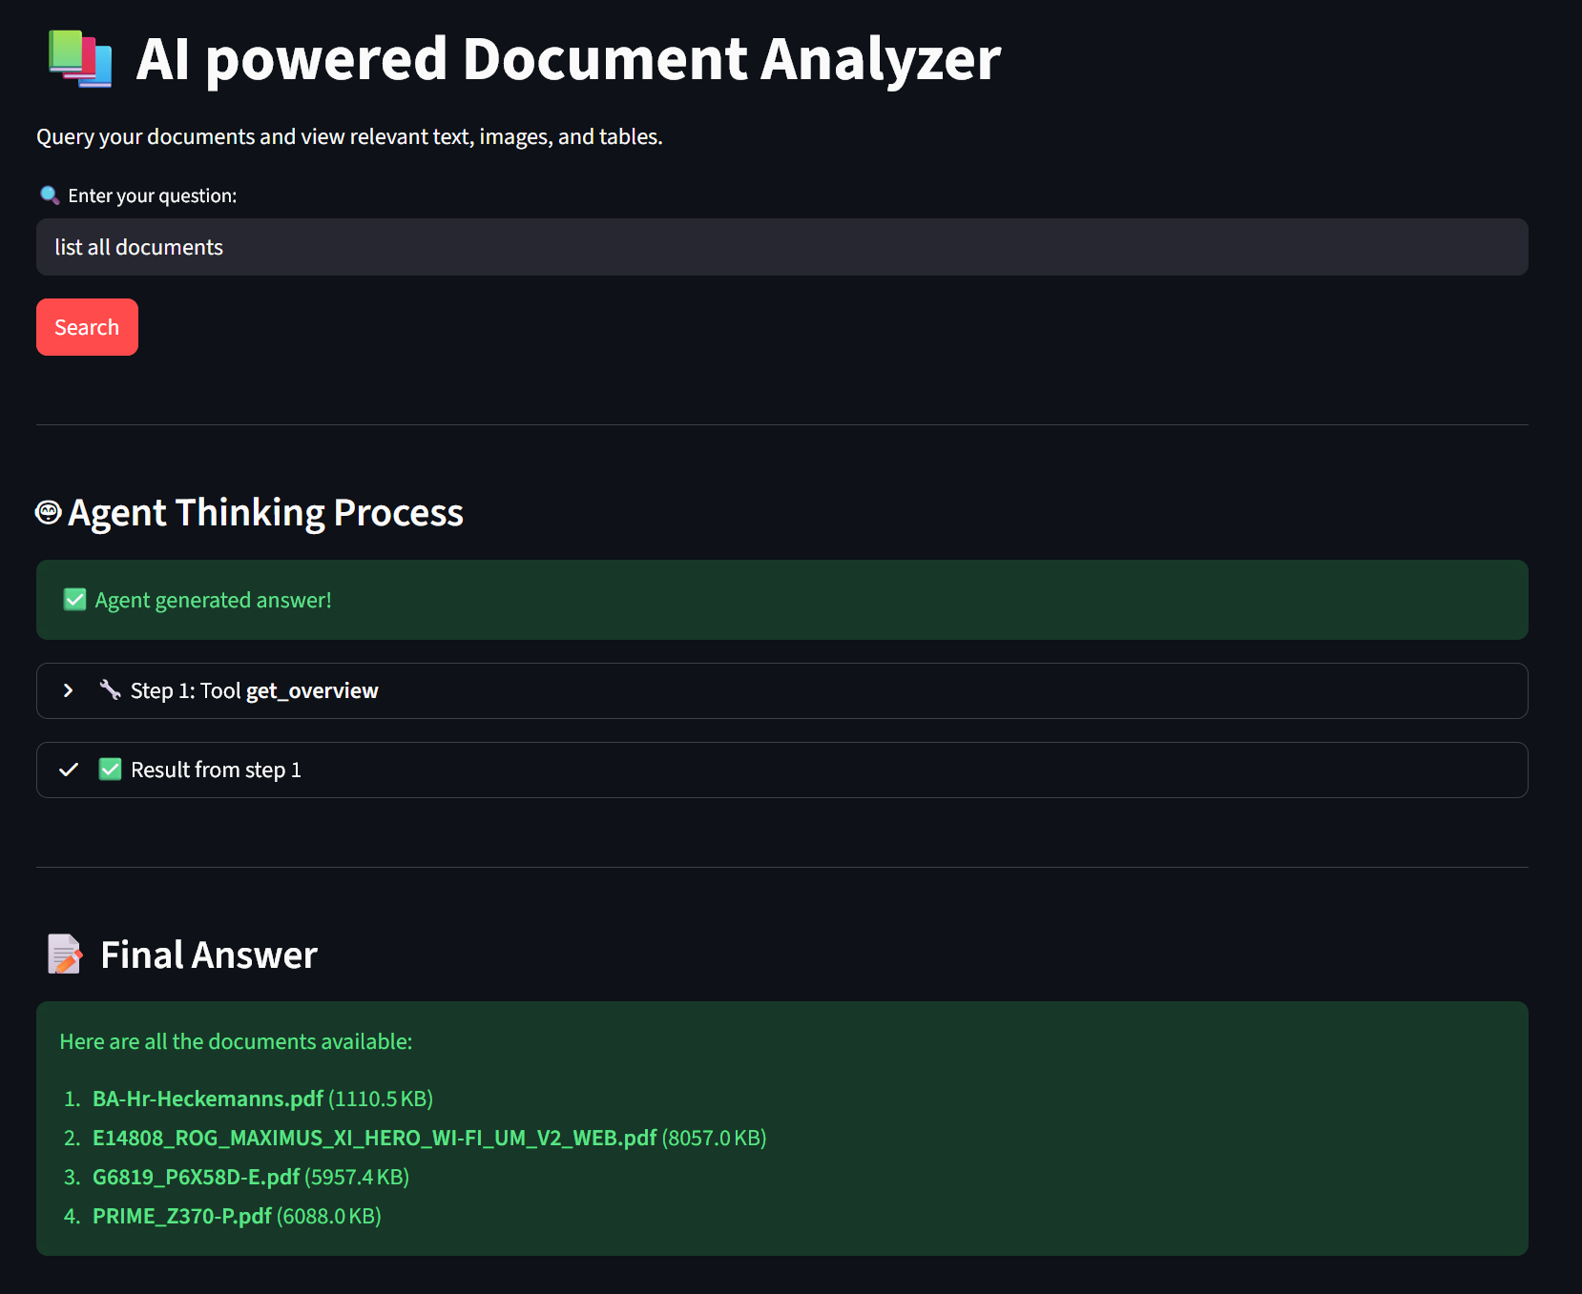
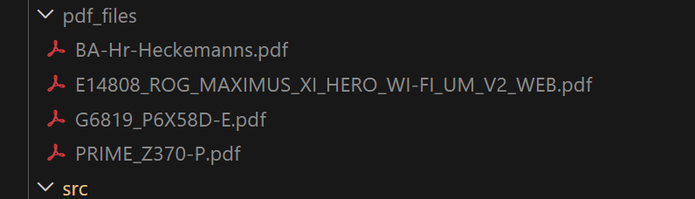
Evaluation – verify correct tools choosing from Agent
Test case: list all documents
Expected tool to use: get_overview()
Expected output: list of all pdf files
Test Result: positive

Slide 10


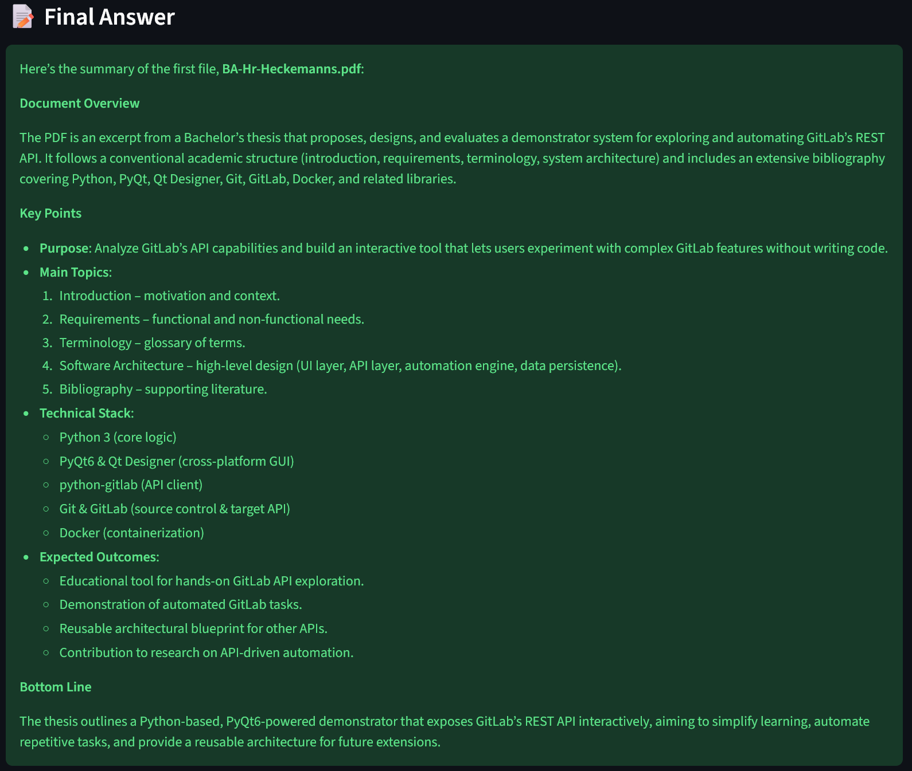
Evaluation – correct tools choosing / memory check
Test case: create summary and test memory
Expected tool to use: summarize_document
Expected ref data: BA-Hr-Heckemanns.pdf
Expected output: correct summary of the file BA-Hr-Heckemanns.pdf
Test Result: positive

Slide 11
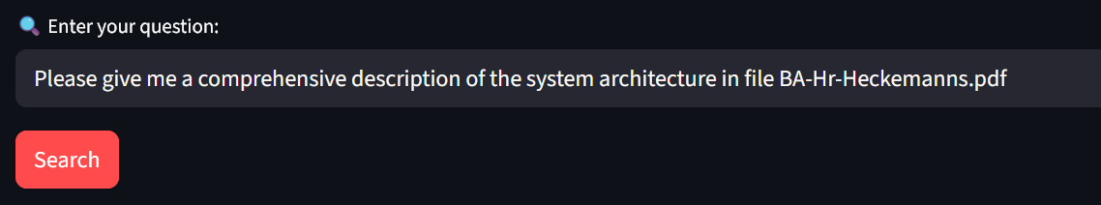
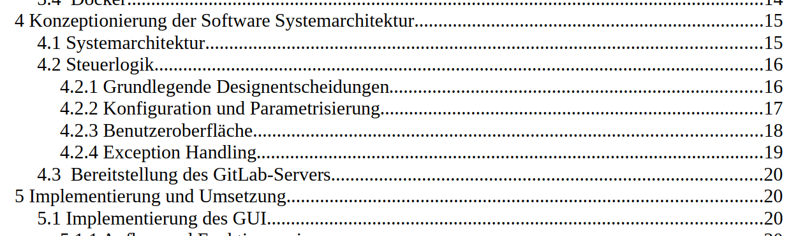
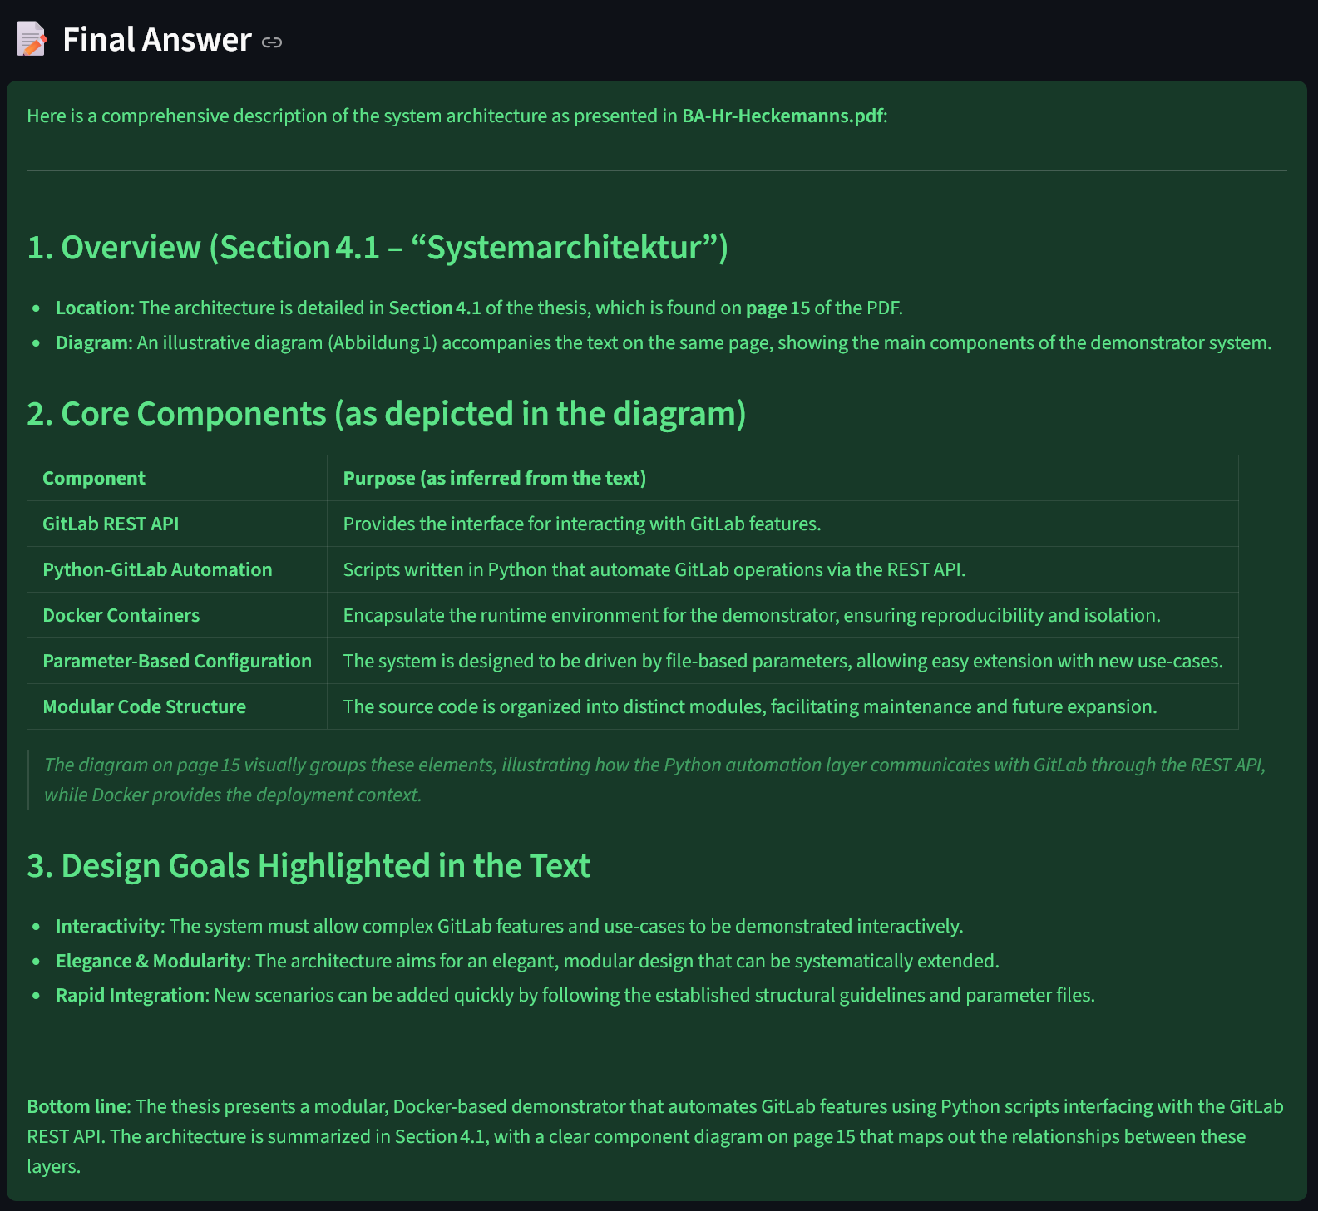
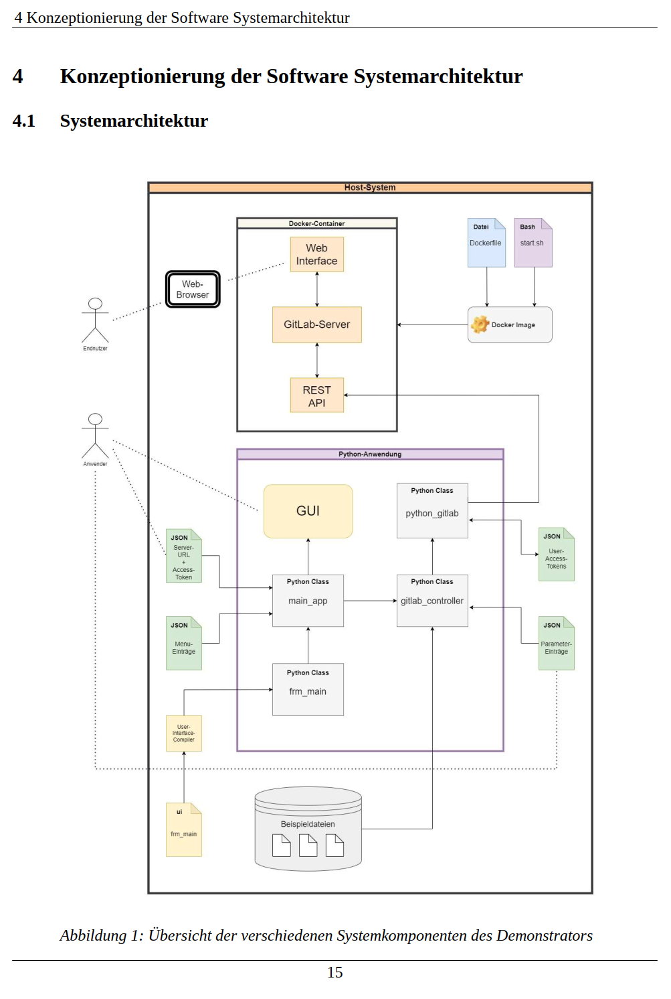
Evaluation – Answer quality
Original File
Test result: positive

Slide 12
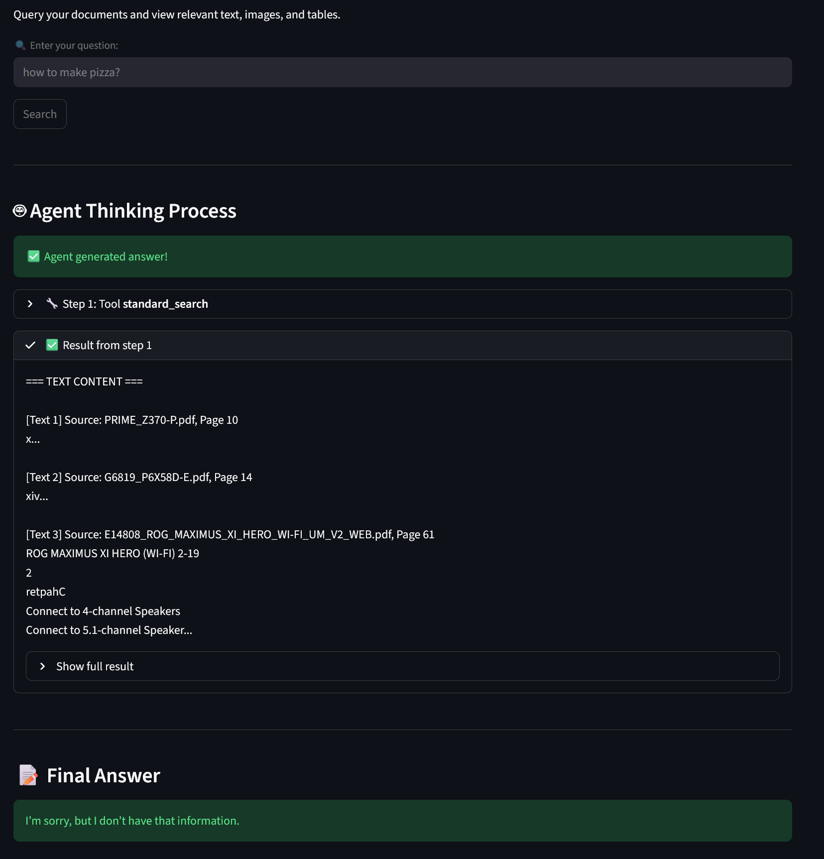
Evaluation – Answer quality
Test case: Test hallucinating
Expected tool to use: standard_search
Expected output: No Information available
Test Result: positive

Slide 13
Evaluation – Summary
With larger models like gpt-oss:20b very accurate results
Smaller models often lack information
Result quality depends also on the promt quality
Sometimes delivers wrong images or no images
No hallucinating detected, but sometimes results out of context
If the used models try to allocate more vram then available, Ollama offloads the workload to the CPU→ massive performance loss

Slide 14
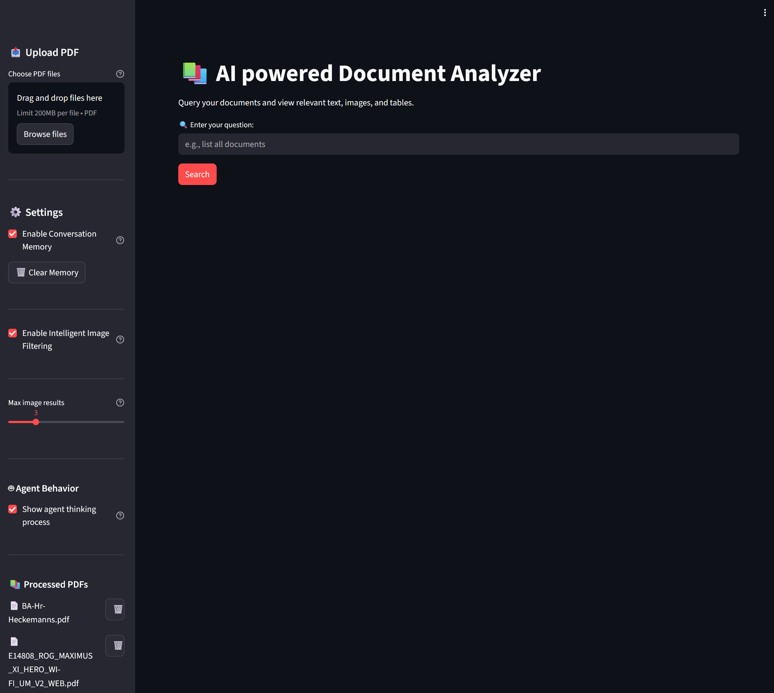
Conclusion
Successfully implemented a RAG system that goes beyond basic text retrieval by integrating multimodal content
Developed an intelligent agent architecture
Achieved full local deployment with Ollama (qwen3-embedding, qwen3-vl:8b, gpt-oss:20b),

Slide 15
DEMO TIME ;)

